Slide 1
Embedded Programming
Jon Wright - Computer Science
Juan Ruiz - Computer Engineering

Slide 2
Data Types
int
float
double
Bool
string
char
Notes:
Chase

Slide 3
Arithmetic Operators
+ addition
- subtraction
* multiplication
/ division
% modulo

Slide 4
Compound Assignment
y++; y = y + 1;
y--; y = y - 1;
y += x; y = y + x;
x -= 5; x = x - 5;
x /= y; x = x / y;

Slide 5
Operators
&& And
|| Or
! Not
== Equal to
!= Not equal to
< Less than
> Greater than
<= Less than or equal to
>= Greater than or equal to

Slide 6
Conditional Statements
if/else
Executes a block of code if a specified condition is true.
switch case
A switch case is used test variable equality for a list of values, where each value is a case. When the variable is equal to one of the cases, the statements following the case are executed.

Slide 7
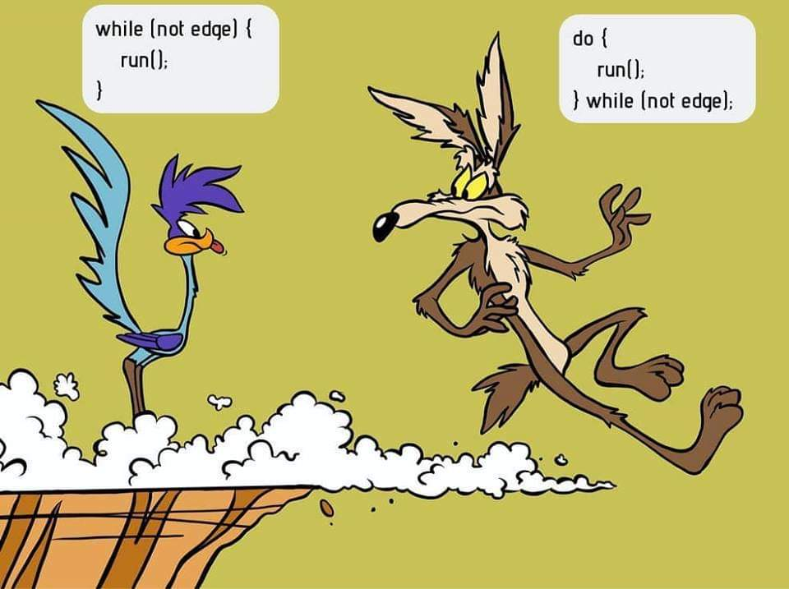
Loops
While
Control flow statement that allows code to be executed repeatedly based on a given Boolean condition.
Do-while
Executes a block of code at least once, and then repeatedly executes the block, or not, depending on a given boolean condition at the end of the block.
For
For-loops are typically used when the number of iterations is known before entering the loop.

Slide 8
Input and Output
cin >>
It is used to accept the input from the standard input device (keyboard).
cout <<
It is used to display the output to the standard output device (monitor).

Slide 9
Functions
Refers to a segment that groups code to perform a specific task.
There are two basic types of functions, ones that do not return a value and those that do return a value.

Slide 10
Practice Time!

Slide 11
https://www.onlinegdb.com/

Slide 12
Embedded Programming Part 2 - 10/023/2019
Hardware Design - 11/06/2019
Systems Design - 11/20/2019

